Slide 1


Enterprise Backend as a Service -
Code that writes code

Slide 2

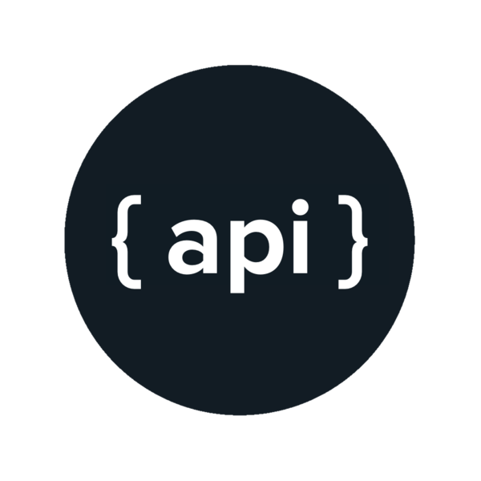

Current Situation
Often, the RESTful APIs deal only with basic manipulation of entities through Create, Update, Retrieve, and Delete(CRUD) operation. These operations manipulate the entities merely by different database queries and nothing more.
Developers – Bounded by deadlines
Even though RESTful APIs are the most basic way to have a backend, there is not a rulebook that one has to adhere to while developing it. In turn, bringing the complexities with structure, style and future compatibility.
RESTful APIs – An absolute basic requirement
for any application, that is, backend.

Slide 3



Objective
Based on the application, find the user requirements
A backend code, written in JavaScript with APIs that manipulates the entities
Finding the appropriate entities to manipulate

Slide 4


How we solved
User Requirements to Entities
Entities to Code that manipulates them
- Create a database based on requirements
Entities
Identify
- Identify the tables
Primary Keys
Constraints
Relationships
- Convert Tables to JavaScript Models
For each primary key: APIs that uses primary keys for indexing.
For each constraint: APIs that uses constraints like unique key to manipulate record based on that field.
Only SQL Databases
JavaScript entities using Sequelize ORM
For each relationship: APIs that control one entity using the relation it has with the other entity. E.g.: Foreign Key

Slide 5








How this works
Backend
Frontend
User Requirements mapped to SQL Schema
User
Provide User Requirements
Database
Schema Info stored to our DB
Schema is mapped to JS Models
The whole express structure with generated APIs
Models are provided to the skeletons, which generate required files
Generates zip
UI Client
Sequelize

Slide 6


What are we bringing new?
Speed and Ease of Use
Usability: Util-raml-code-generator requires knowledge of working with RAML files which easily eliminates a huge subset of users. EBaaS eliminates any such indulgence of technologies.
Speediness: The time required by util-raml-code-generator from setting up the tools to getting the code generated is too long. EBaaS doesn’t suffer from speed issues as it gives user directly the interface to interact without them needing to setup the tools.
Enterprise Backend as a Service(EBaaS)
Paysera/util-raml-code-generator

Slide 7

What are we bringing new?
RESTful API Code –
On Hand
Services Provided:
Both these services mentioned, that is, Xmysql and Sandman2 gives the user a server, not the code, that will work as a backend and in turn robs the user from adding/deleting/modifying the APIs.
On the other hand, EBaaS provides users with the actual code which can then be used as a base to create more complex backend applications.
Enterprise Backend as a Service(EBaaS)
o1lab/xmysql
and
jeffknupp/sandman2

Slide 8
What are we bringing new?
Database Manipulation
Database Services:
Again, Xmysql and Sandman2 allows users to connect to an existing database and not providing the feature of creating one.
EBaaS fills that void and not only creates a database from scratch but also allows users to modify their existing database they wish to connect. This feature targets to connect the users with less to no knowledge of database to interact with our system.
Enterprise Backend as a Service(EBaaS)
o1lab/xmysql
and
jeffknupp/sandman2

Slide 9

Demo
Let’s put EBaaS to work

Slide 10




Our Team
Aditya Doshatti
Software Engineering, MS
Darshil Kapadia
Software Engineering, MS
Devashish Nyati
Software Engineering, MS
Maulin Bodiwala
Computer Engineering, MS
CMPE 295: Masters Project
Under the guidance of
Prof. Gokay Saldamli

